Slide 1
Docker
Hima Varsha Somuri
FARYAL BAREEN
M.N Ankitha
Godavari Krishna Sujith

Slide 2
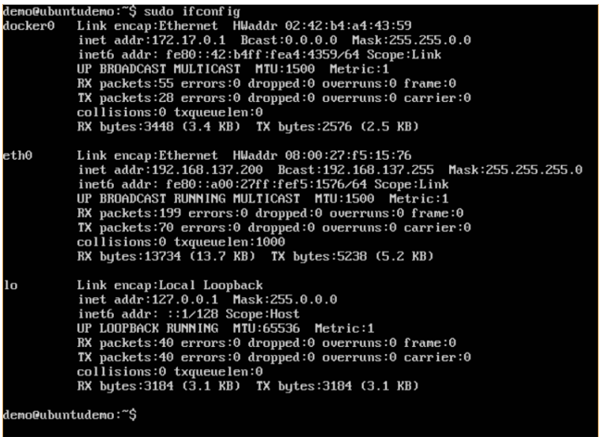
Docker Networking
Docker takes care of the networking , so that the containers can communicate with other containers and also with the Docker Host. If you do an ifconfig on the Docker Host, you will see the Docker Ethernet adapter. This adapter is created when Docker is installed on the Docker Host.

Slide 3
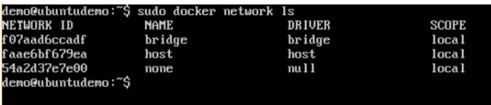
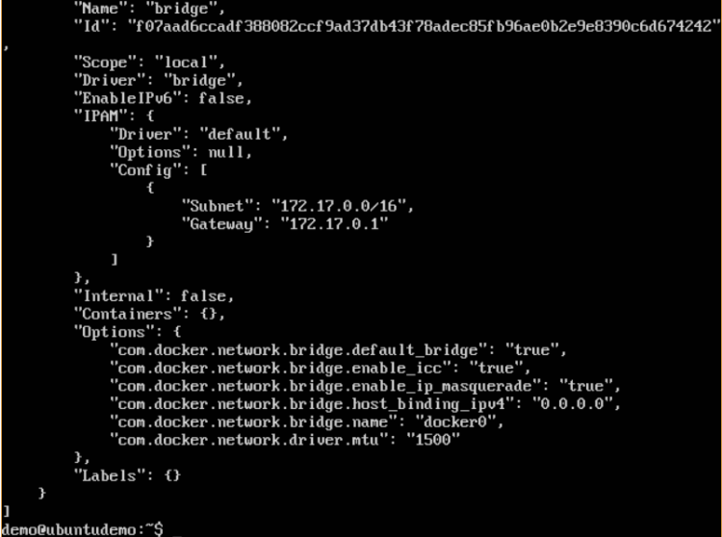
Listing All Docker Networks
This command can be used to list all the networks associated with Docker on the host.
Syntax:docker network ls
Options: None
Return Value :The command will output all the networks on the Docker Host.
Example:sudo docker network ls
Output:
Inspecting a Docker network
If you want to see more details on the network associated with Docker, you can use the Docker network inspect command.
Syntax:docker network inspect networkname
Options :
networkname – This is the name of the network you need to inspect.
Return Value :The command will output all the details about the network.
Example:sudo docker network inspect bridge
Output: The output of the above command is shown below:

Slide 4

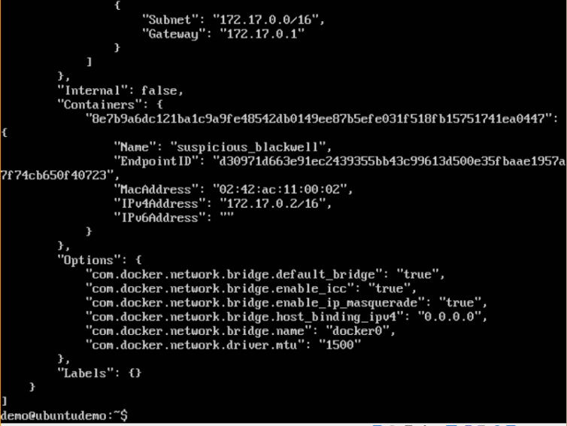
Now let’s run a container and see what happens when we inspect the network again. Let’s spin up an Ubuntu container with the following command:
Syntax: sudo docker run –it ubuntu:latest /bin/bash
Now if we inspect our network name via the following command, you will now see that the container is attached to the bridge.
Syntax :sudo docker network inspect bridge
Creating Your Own New Network
One can create a network in Docker before launching containers. This can be done with the following command:
Syntax:docker network create –-driver drivername name
Options :
drivername – This is the name used for the network driver.
name – This is the name given to the network.
Return Value :The command will output the long ID for the new network.
Example: sudo docker network create –-driver bridge new_nw

Slide 5
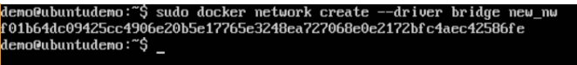

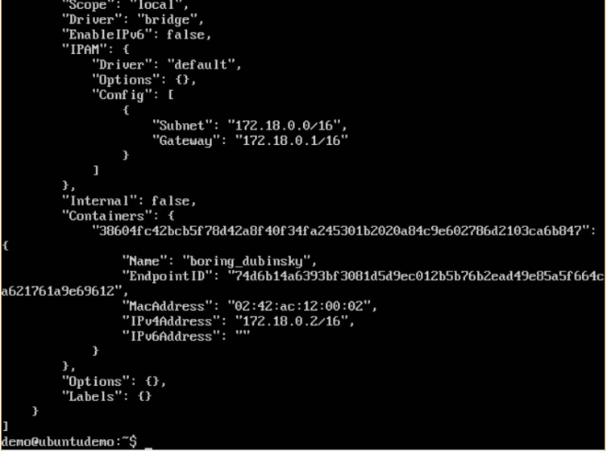
Output :The output of the above command is shown below:
You can now attach the new network when launching the container. So let’s spin up an Ubuntu container with the following command:
Syntax:- sudo docker run –it –network=new_nw ubuntu:latest /bin/bash
And now when you inspect the network via the following command, you will see the container attached to the network.
Syntax: sudo docker network inspect new_nw

Slide 6
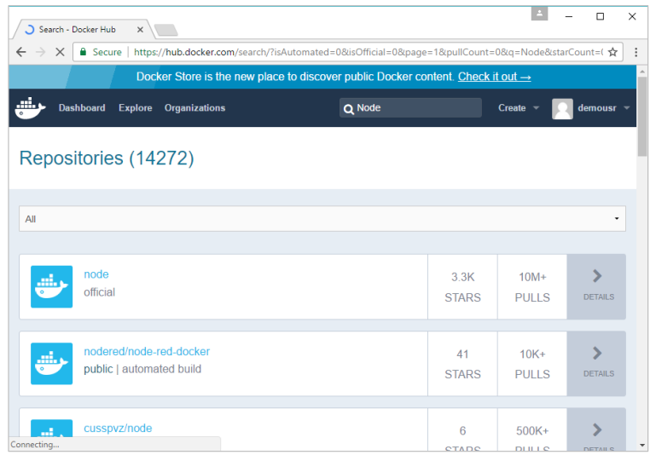
Setting Node.js
Node.js is a JavaScript framework that is used for developing server-side applications.
It is an open source framework that is developed to run on a variety of operating systems.
Since Node.js is a popular framework for development, Docker has also ensured it has support for Node.js applications.
Here are various steps for getting the Docker container for Node.js up and running.
Step 1: The first step is to pull the image from Docker Hub. When you log into Docker Hub, you will be able to search and see the image for Node.js as shown below. Just type in Node in the search box and click on the node official link which comes up in the search results.

Slide 7
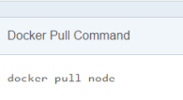
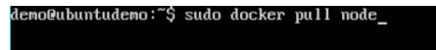
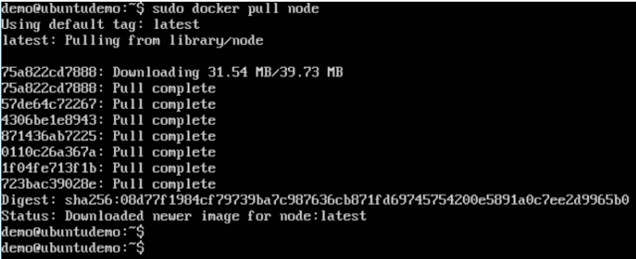
Step 2: You will see that the Docker pull command for node in the details of the repository in Docker Hub.
Step 3: On the Docker Host, use the Docker pull command as shown above to download the latest node image from Docker Hub.
Once the pull is complete, we can then proceed with the next step.

Slide 8
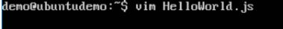
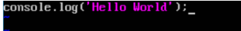
Step 4: On the Docker Host, let’s use the vim editor and create one Node.js example file. In this file, we will add a simple command to display “HelloWorld” to the command prompt.
In the Node.js file, let’s add the following statement:
Example: Console.log(‘Hello World’);
This will output the “Hello World” phrase when we run it through Node.js.
Ensure that you save the file and then proceed to the next step.
Step 5: To run our Node.js script using the Node Docker container, we need to execute the following statement:
Syntax :sudo docker run –it –rm –name=HelloWorld –v “$PWD”:/usr/src/app –w /usr/src/app node node HelloWorld.js
The following points need to be noted about the above command:
The –rm option is used to remove the container after it is run.
We are giving a name to the container called “HelloWorld”
We are mentioning to map the volume in the container which is /usr/src/app to our current present working

Slide 9
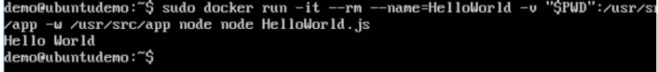
directory. This is done so that the node container will pick up our HelloWorld.js script which is present in our working directory on the Docker Host.
The –w option is used to specify the working directory used by Node.js.
The first node option is used to specify to run the node image.
The second node option is used to mention to run the node command in the node container.
And finally we mention the name of our script. We will then get the following output. And from the output, we can clearly see that the Node container ran as a container and executed the HelloWorld.js script.

Slide 10

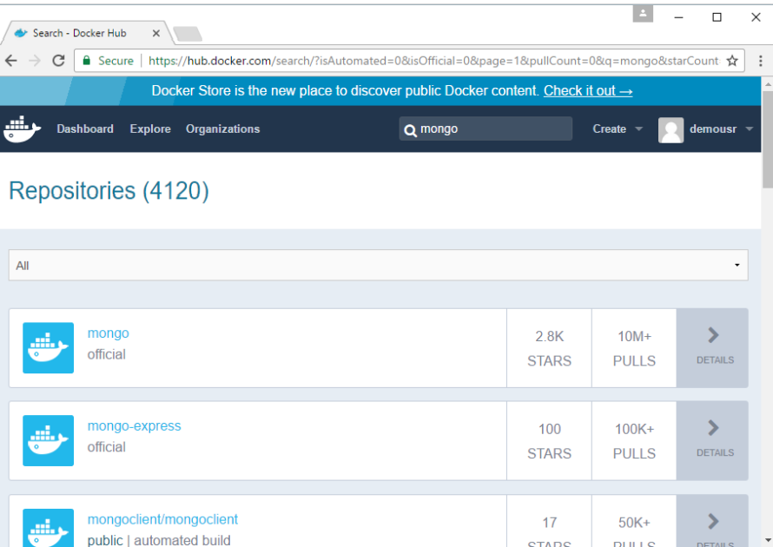
Docker – Setting MongoDB
MongoDB is a famous document-oriented database that is used by many modern-day web applications.
Step 1: The first step is to pull the image from Docker Hub.

Slide 11
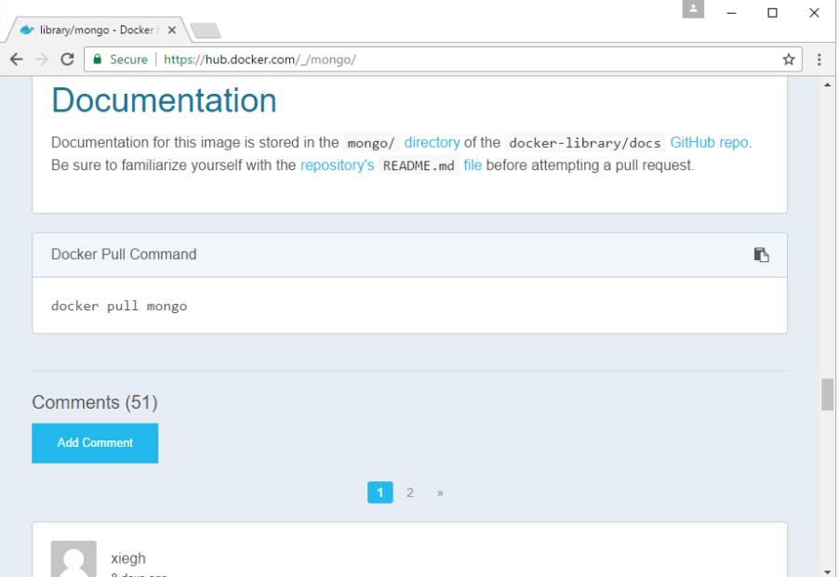
Step 2:

Slide 12

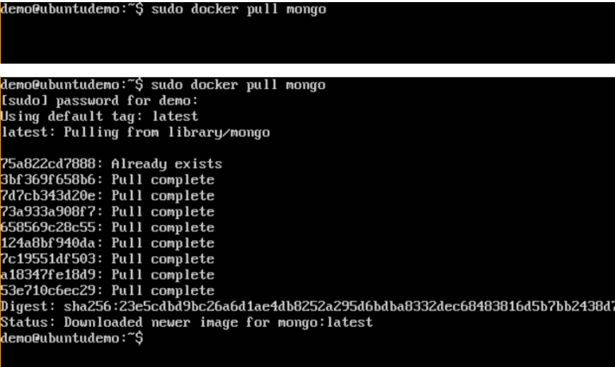



Step-3

Slide 13
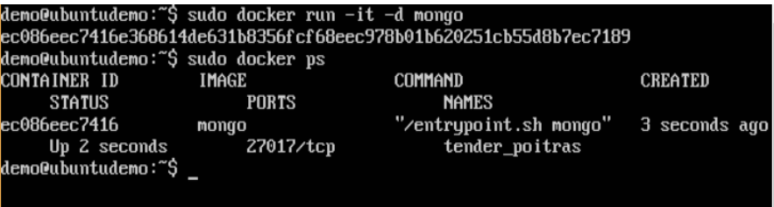
Step 4:
Now that we have the image for Mongo, let’s first run a MongoDB container which will be our instance for MongoDB.
sudo docker –it –d mongo

Slide 14
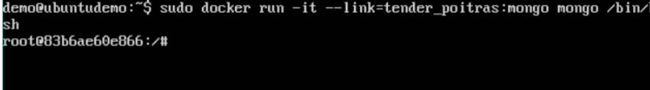
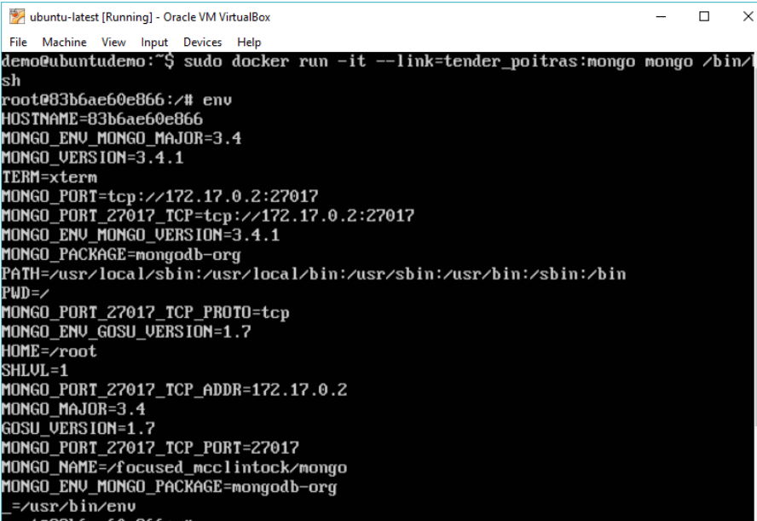
Step 5:
Now let’s spin up another container which will act as our client which will be used to connect to the MongoDB database.
sudo docker run –it –link=tender_poitras:mongo mongo /bin/bash
sudo docker run –it –link=tender_poitras:mongo mongo /bin/bash

Slide 15
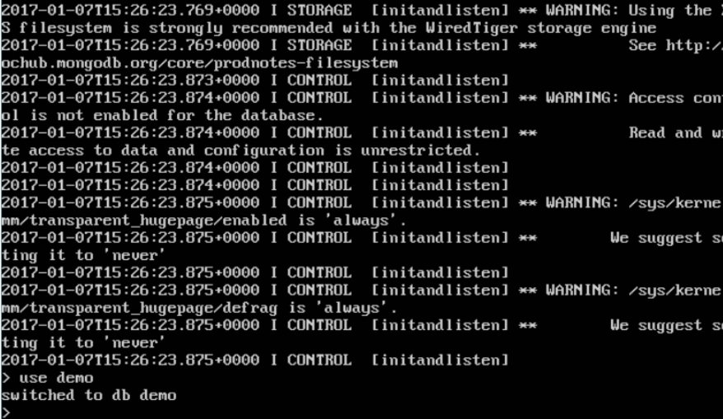
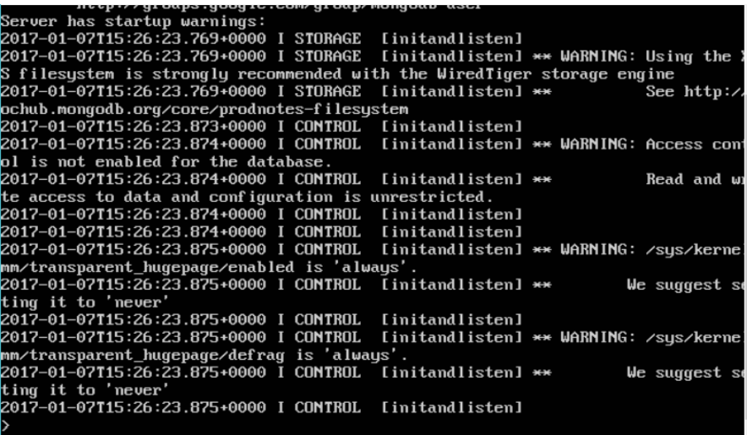
Step 6:
Now it’s time to connect to the MongoDB server from the client container.
mongo 172.17.0.2:27017
use demo

Slide 16
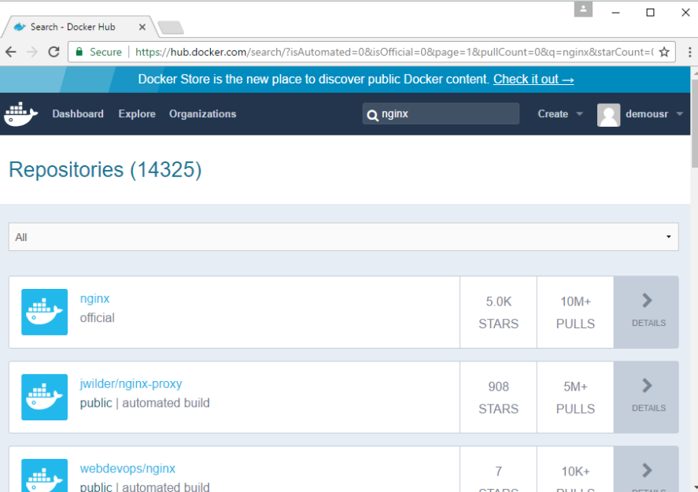
Docker – Setting NGINX
NGINX is a popular lightweight web application that is used for developing server-side applications.
Step 1: The first step is to pull the image from Docker Hub.

Slide 17
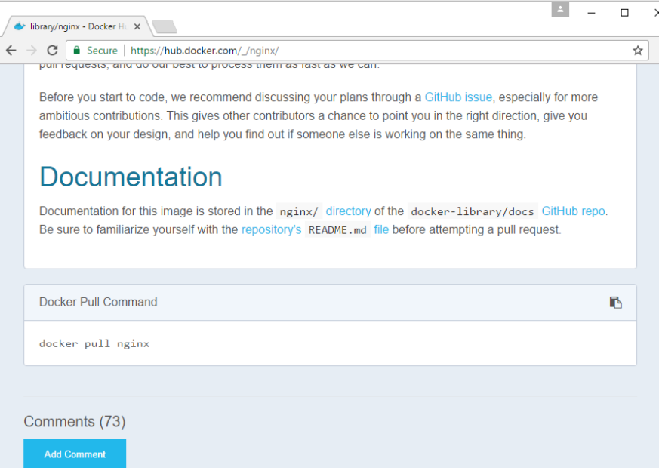
Step 2:
You will see that the Docker pull command for nginx in the details of the repository in Docker Hub.

Slide 18
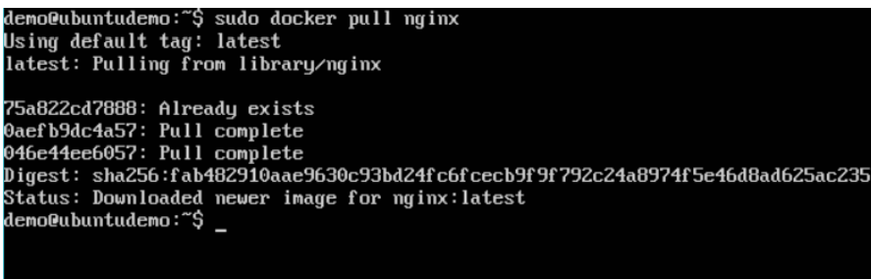
Step 3:
On the Docker Host, use the Docker pull command.

Slide 19
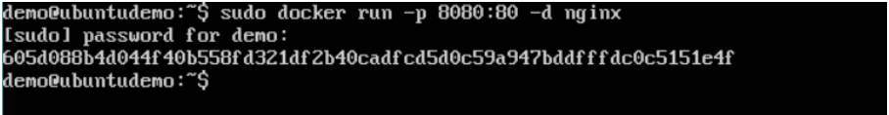
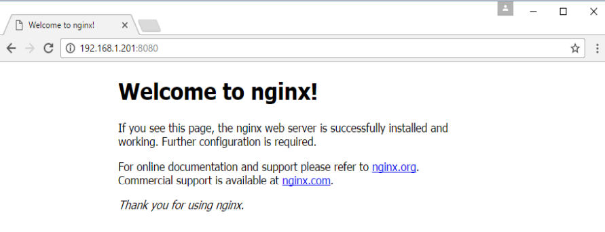
Step 4:
Now let’s run the nginx container via the following command:
sudo docker run –p 8080:80 –d nginx

Slide 20
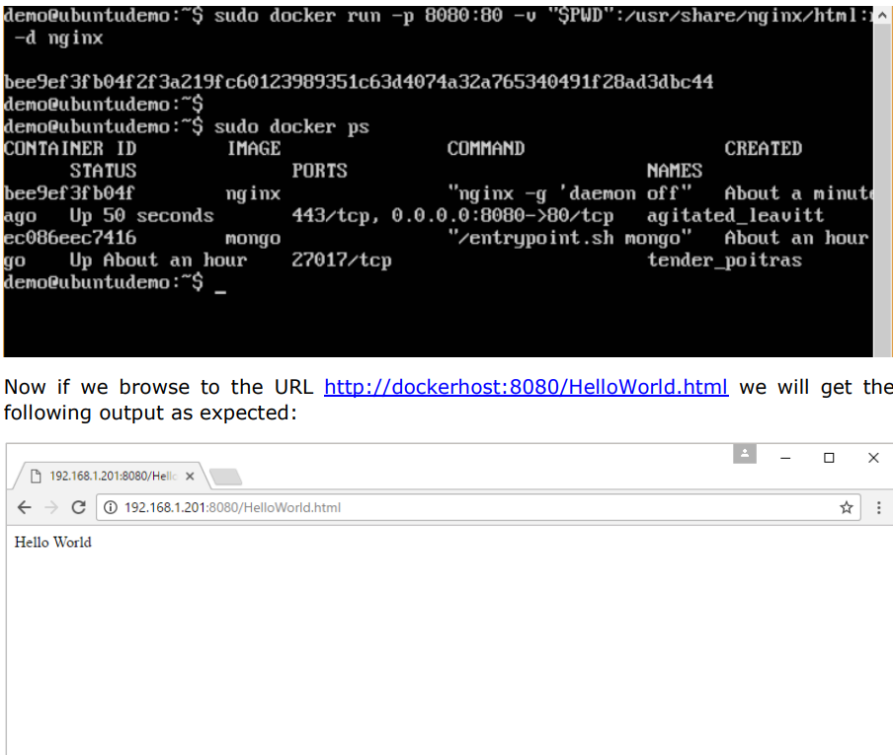
Step 5:
Let’s first create an HTML file called HelloWorld.html
sudo docker run –p 8080:80 –v “$PWD”:/usr/share/nginx/html:ro –d nginx

Slide 21
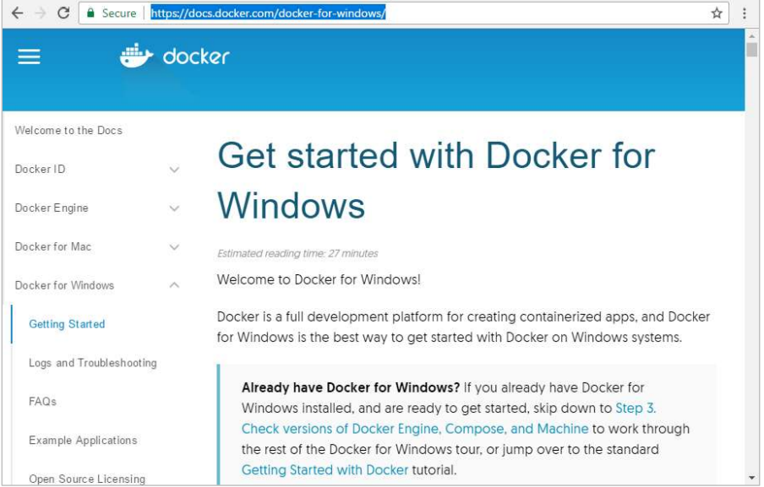
Docker – Docker Toolbox
The toolbox consists of the following component.
Docker Engine
Docker Machine
Docker Compose
Kinematic
Oracle virtualbox

Slide 22
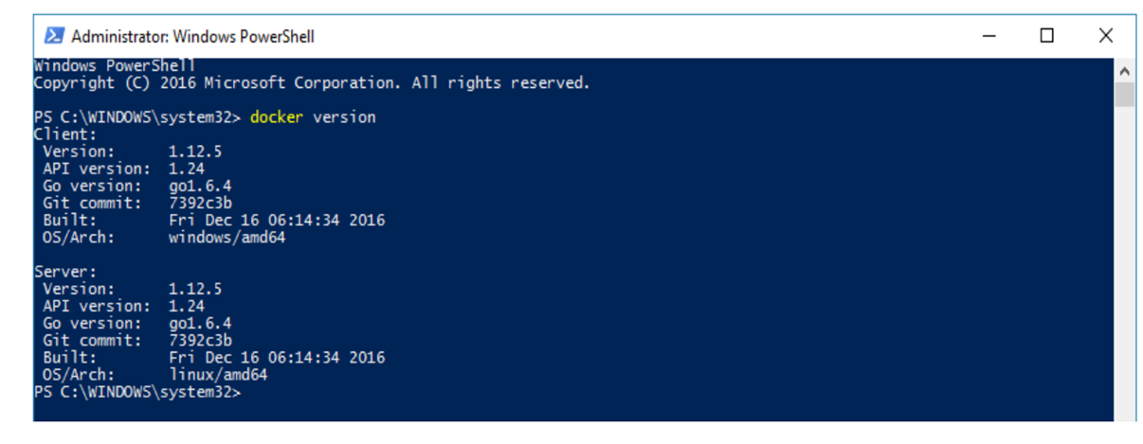
Running in Powershell
With Docker toolbox on Windows 10, you can now run Docker commands off powershell.
If you open powershell on Windows and type in the command of Docker version, you will get all the required details about the Docker version installed.

Slide 23
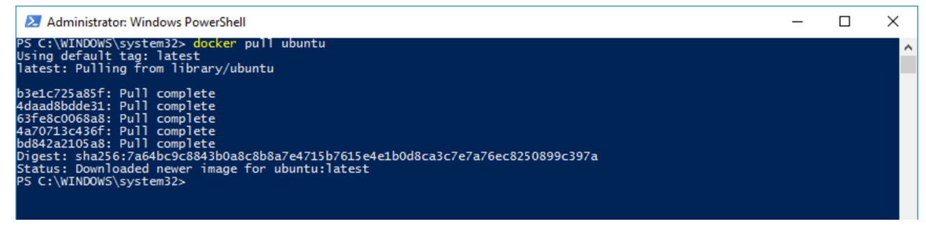
Pulling Images and Running Containers
The following example will show the downloading of the Ubuntu image and running of the container off the image.
1. The first step is to use the Docker pull command to pull the Ubuntu image from Docker Hub.
2. The next step is to run the Docker image using the following run command:
docker run –it ubuntu /bin/bash

Slide 24
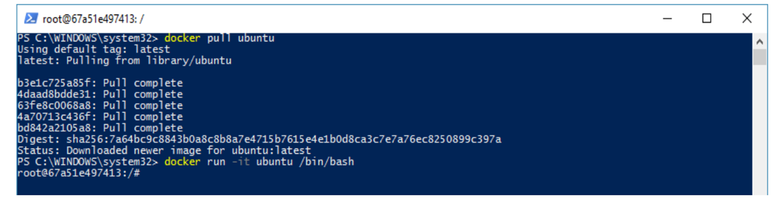
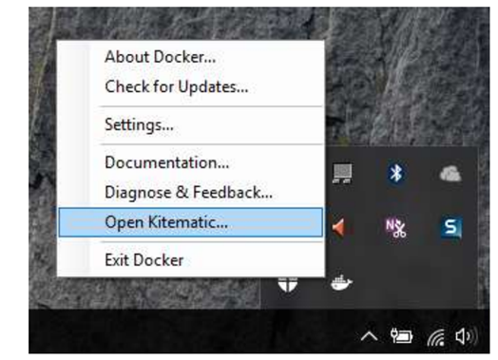
You will notice that the command is the same as it was in Linux.
Kitematic
This is the GUI equivalent of Docker on Windows. To open this GUI, go to the taskbar and on the Docker icon, right-click and choose to open Kitematic.

Slide 25
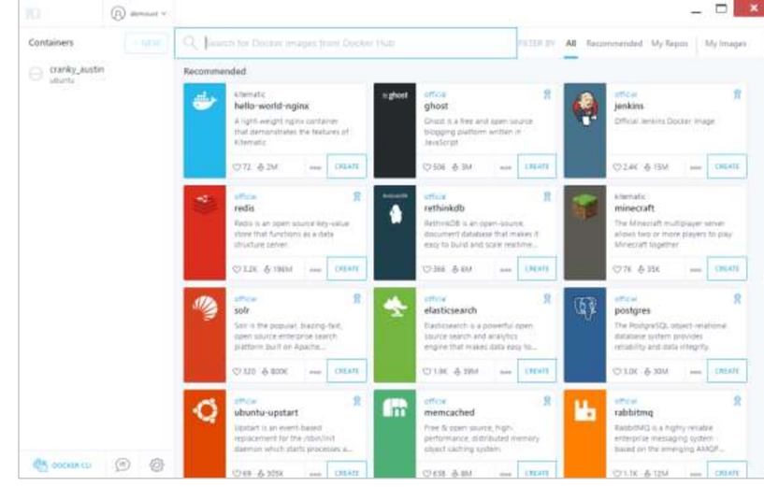
It will prompt you to download Kitematic GUI. Once downloaded, just unzip the contents. There will be a file called Kitematic.exe. Double-click this exe file to open the GUI interface.
You will then be requested to log into Docker Hub, enter through the GUI. Just enter the required username and password and then click the Login button.
Once logged in, you will be able to see all the images downloaded on the system on the left-hand side of the interface.
On the right-hand side, you will find all the images available on Docker Hub.

Slide 26
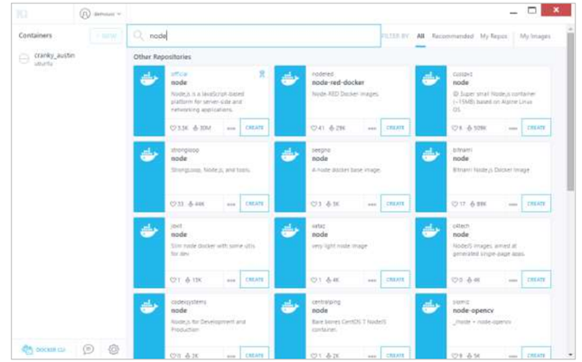
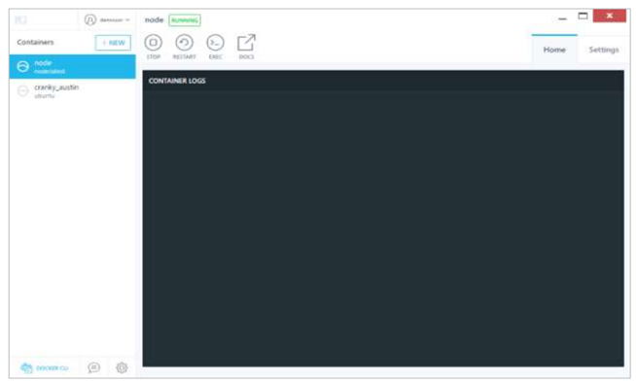
Let’s take an example to understand how to download the Node image from Docker Hub using Kitematic.
Step 1: Enter the keyword of node in the search criteria.
Step 2: Click the create button on official Node image. You will then see the image being downloaded.
Once the image has been downloaded, it will then start running the Node container.

Slide 27
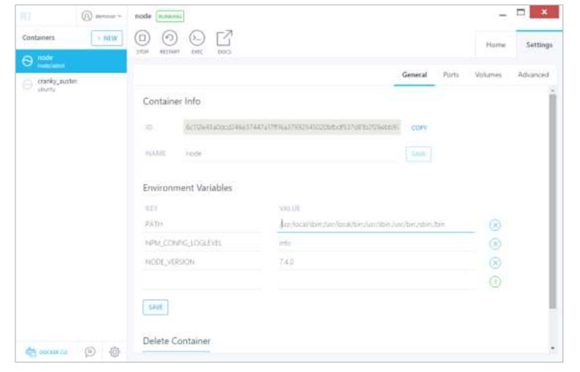
Step 3: If you go to the settings tab, you can drill-down to further settings options.
General settings – In this tab, you can name the container, change the path settings, and delete the container.
Ports – Here you can see the different port mappings. If you want, you can create your own port mappings.
Volumes - Here you can see the different volume mappings.
Advanced – It contains the advanced settings for the container.

Slide 28
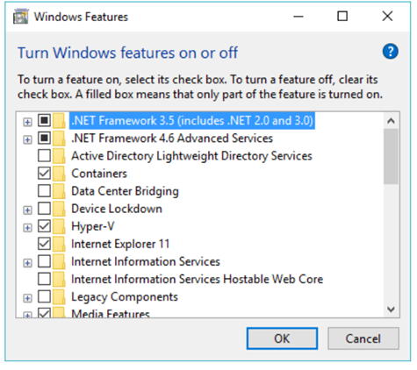
Docker – Setting ASP.Net
ASP.Net is the standard web development framework that is provided by Microsoft for developing server-side applications.
Prerequisites
The following steps need to be carried out first for running ASP.Net.
Step 1: Since this can only run on Windows systems, you first need to ensure that you have either Windows 10 or Window Server 2016.
Step 2: Next, ensure that Hyper-V is and Containers are installed on the Windows system. To install Hyper–V and Containers, you can go to Turn Windows Features ON or OFF. Then ensure the Hyper-V option and Containers is checked and click the OK button.

Slide 29
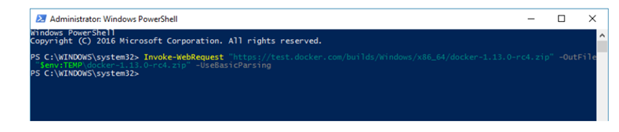
Step 3: Next, you need to use the following Powershell command to install the 1.13.0- rc4 version of Docker. The following command will download this and store it in the temp location.
Invoke-WebRequest "https://test.docker.com/builds/Windows/x86_64/docker-1.13.0- rc4.zip"
-OutFile "$env:TEMP\docker-1.13.0-rc4.zip" –UseBasicParsing
Step 4: Next, you need to expand the archive using the following powershell command.
Expand-Archive -Path "$env:TEMP\docker-1.13.0-rc4.zip" -DestinationPath $env:ProgramFiles
Step 5: Next, you need to add the Docker Files to the environment variable using the following powershell command.
$env:path += ";$env:ProgramFiles\Docker“
Step 6: Next, you need to register the Docker Daemon Service using the following powershell command.
dockerd --register-service
Step 7: Finally, you can start the docker daemon using the following command.
Start-Service Docker
Use the docker version command in powershell to verify that the docker daemon is working

Slide 30
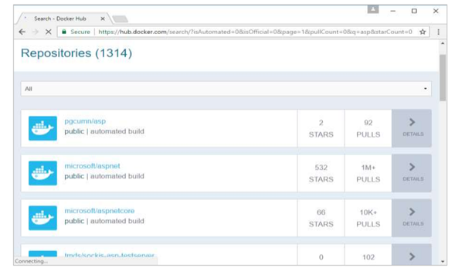
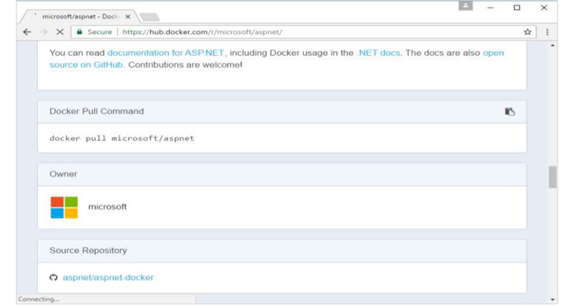
Installing the ASP.Net Container
Step 1: The first step is to pull the image from Docker Hub. When you log into Docker Hub, you will be able to search and see the image for Microsoft/aspnet
Step 2: You will see that the Docker pull command for ASP.Net in the details of the repository in Docker Hub.

Slide 31
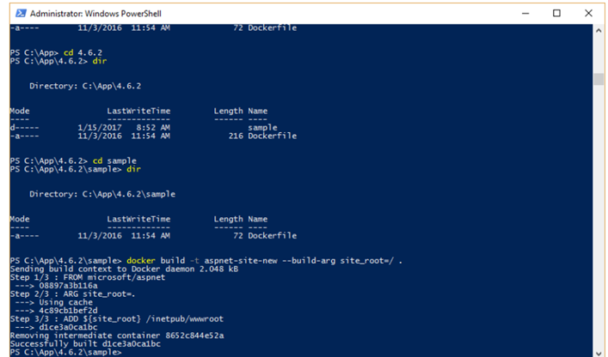
Step 3: Go to Docker Host and run the Docker pull command for the microsoft/aspnet image.
Step 4: Now go to the following location https://github.com/Microsoft/aspnet-docker and download the entire Git repository.
Step 5: Create a folder called App in your C drive. Then copy the contents from the 4.6.2/sample folder to your C drive. Go the Docker File in the sample directory and issue the following command:
docker build –t aspnet-site-new –build-arg site_root=/
Step 6: Now it’s time to run the container. It can be done using the following command:
docker run –d –p 8000:80 –name my-running-site-new aspnet-site-new

Slide 32
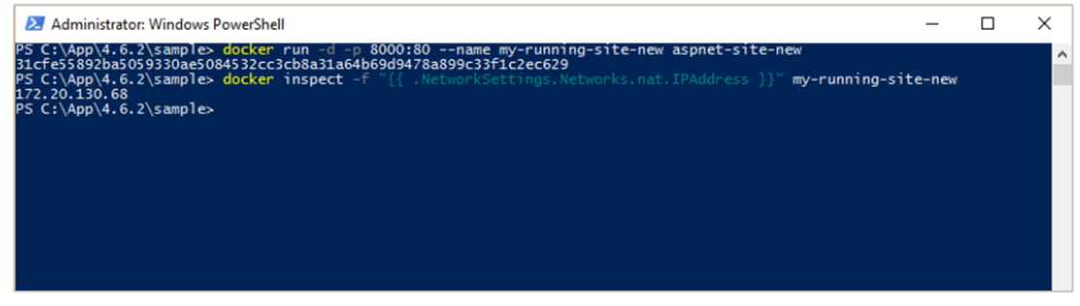
Step 7: You will now have IIS running in the Docker container. To find the IP Address of the Docker container, you can issue the Docker inspect command as shown below.

Slide 33
DOCKER – DOCKER CLOUD
Docker cloud is a service provided by Docker in which you can carry out different operations.
NODES :
Connect the Docker cloud to the existing cloud providers like aws, azure to spin up the containers.
CLOUD REPOSITORY :
Provides a place where you can store own repositories
CONTINOUS INTEGRATION (CI) :
Connect with Github and build a continuous integration pipeline

Slide 34
APPLICATION DEVELOPMENT :
Deploy and scale infra and containers
CONTINUOUS DEPLOYMENT :
Can automate deployments

Slide 35
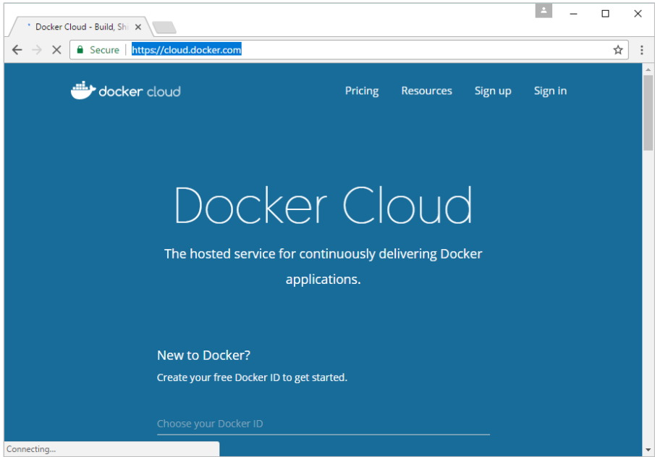
Getting started
You can go to the following link to getting started with Docker Cloud: https://cloud.docker.com/

Slide 36
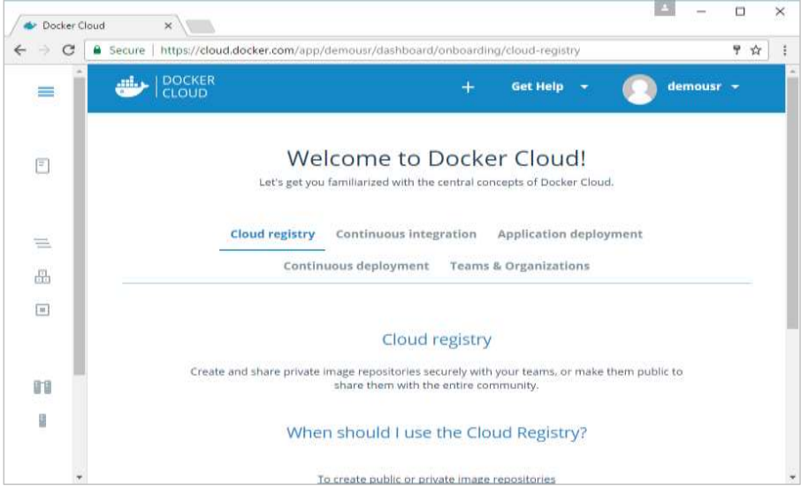
Once logged in, you will be provided with the following basic interface:

Slide 37
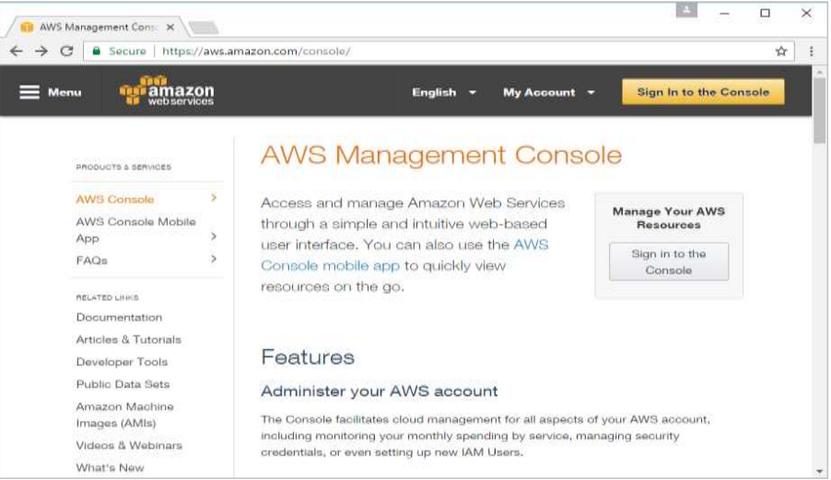
Connecting to the Cloud Provider
Step 1:
The first step is to ensure that you have the right AWS keys. This can be taken from the aws console. Log into your aws account using the following link - https://aws.amazon.com/console.

Slide 38
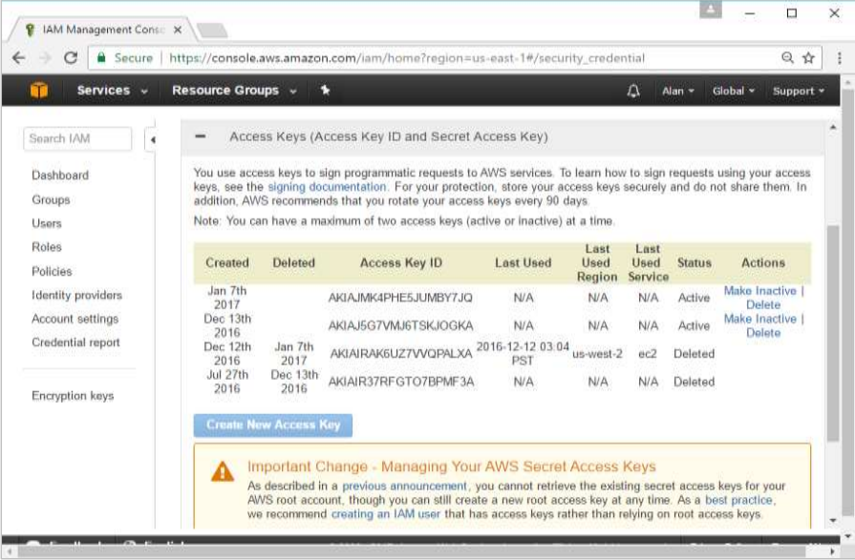
Step 2:
Once logged in, go to the Security Credentials section. Make a note of the access keys which will be used from Docker Hub.

Slide 39
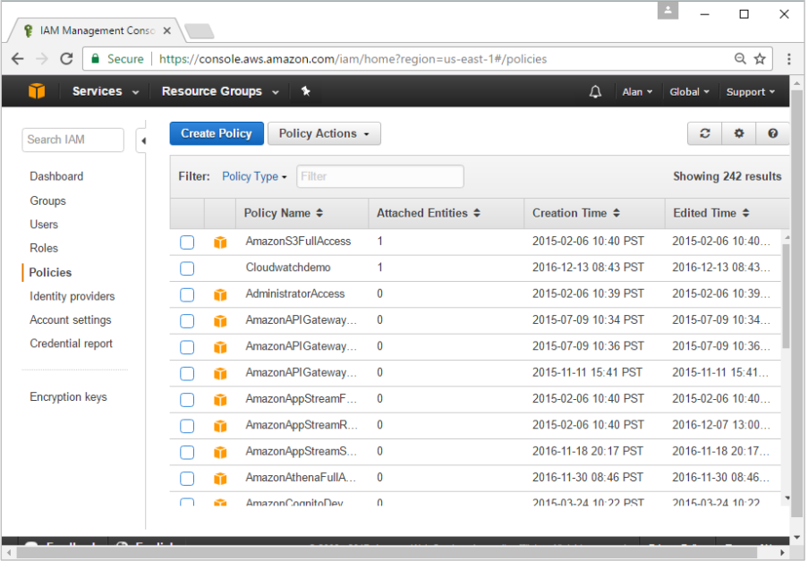
Step 3:
Next, you need to create a policy in aws that will allow Docker to view EC2 instances. Go to the profiles section in aws. Click the Create Policy button.

Slide 40
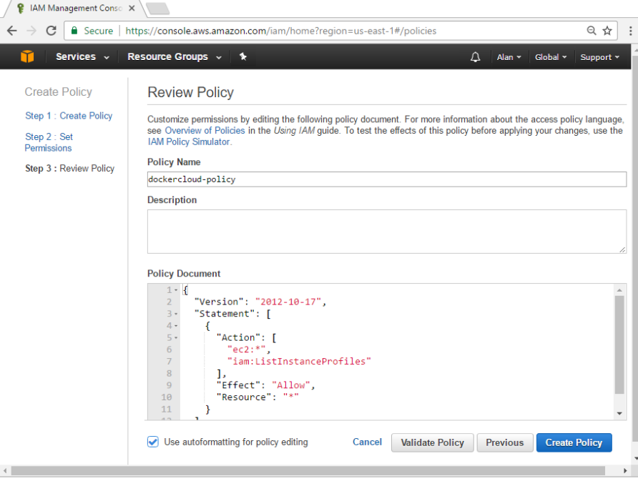
Step 4:
Click on ‘Create Your Own Policy’ and give the policy name as dockercloudpolicy and the policy definition as shown below.
Next, click the Create Policy button.

Slide 41
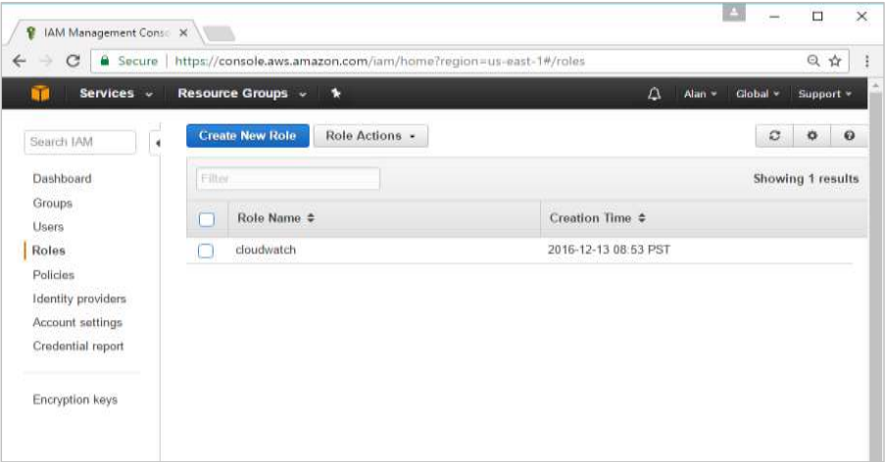
Step 5:
Next, you need to create a role which will be used by Docker to spin up nodes on AWS. For this, go to the Roles section in AWS and click the Create New Role option.

Slide 42
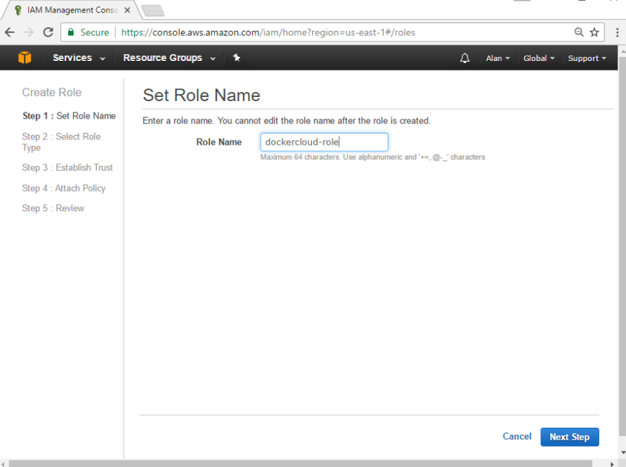
Step 6:
Give the name for the role as dockercloud-role

Slide 43

Step 7:
On the next screen, go to ‘Role for Cross Account Access’ and select “Provide access between your account and a 3rd party AWS account”

Slide 44

Step 8:
On the next screen, enter the following details:
In the Account ID field, enter the ID for the Docker Cloud service: 689684103426.
In the External ID field, enter your Docker Cloud username.

Slide 45

Step 9:
Then, click the Next Step button and on the next screen, attach the policy which was created in the earlier step.

Slide 46

Step 10: Finally, on the last screen when the role is created, make sure to copy the arn role which is created.

Slide 47


Step 11: Now go back to Docker Cloud, select Cloud Providers, and click the plug symbol next to Amazon Web Services.

Slide 48

Once saved, the integration with AWS would be complete

Slide 49
Setting Up Nodes
Once the integration with AWS is complete, the next step is to setup a node.
Go to the Nodes section in Docker Cloud. Note that the setting up of nodes will automatically setup a node cluster first.

Slide 50
THANK YOU

